Slide 1
Cambio climático, Humboldt, cueva y zombies

Slide 2
Porcentaje de contribución de la agricultura familiar a la alimentación mundial
Efecto del cambio climático en el desplazamiento altitudinal de las plantas

Slide 3
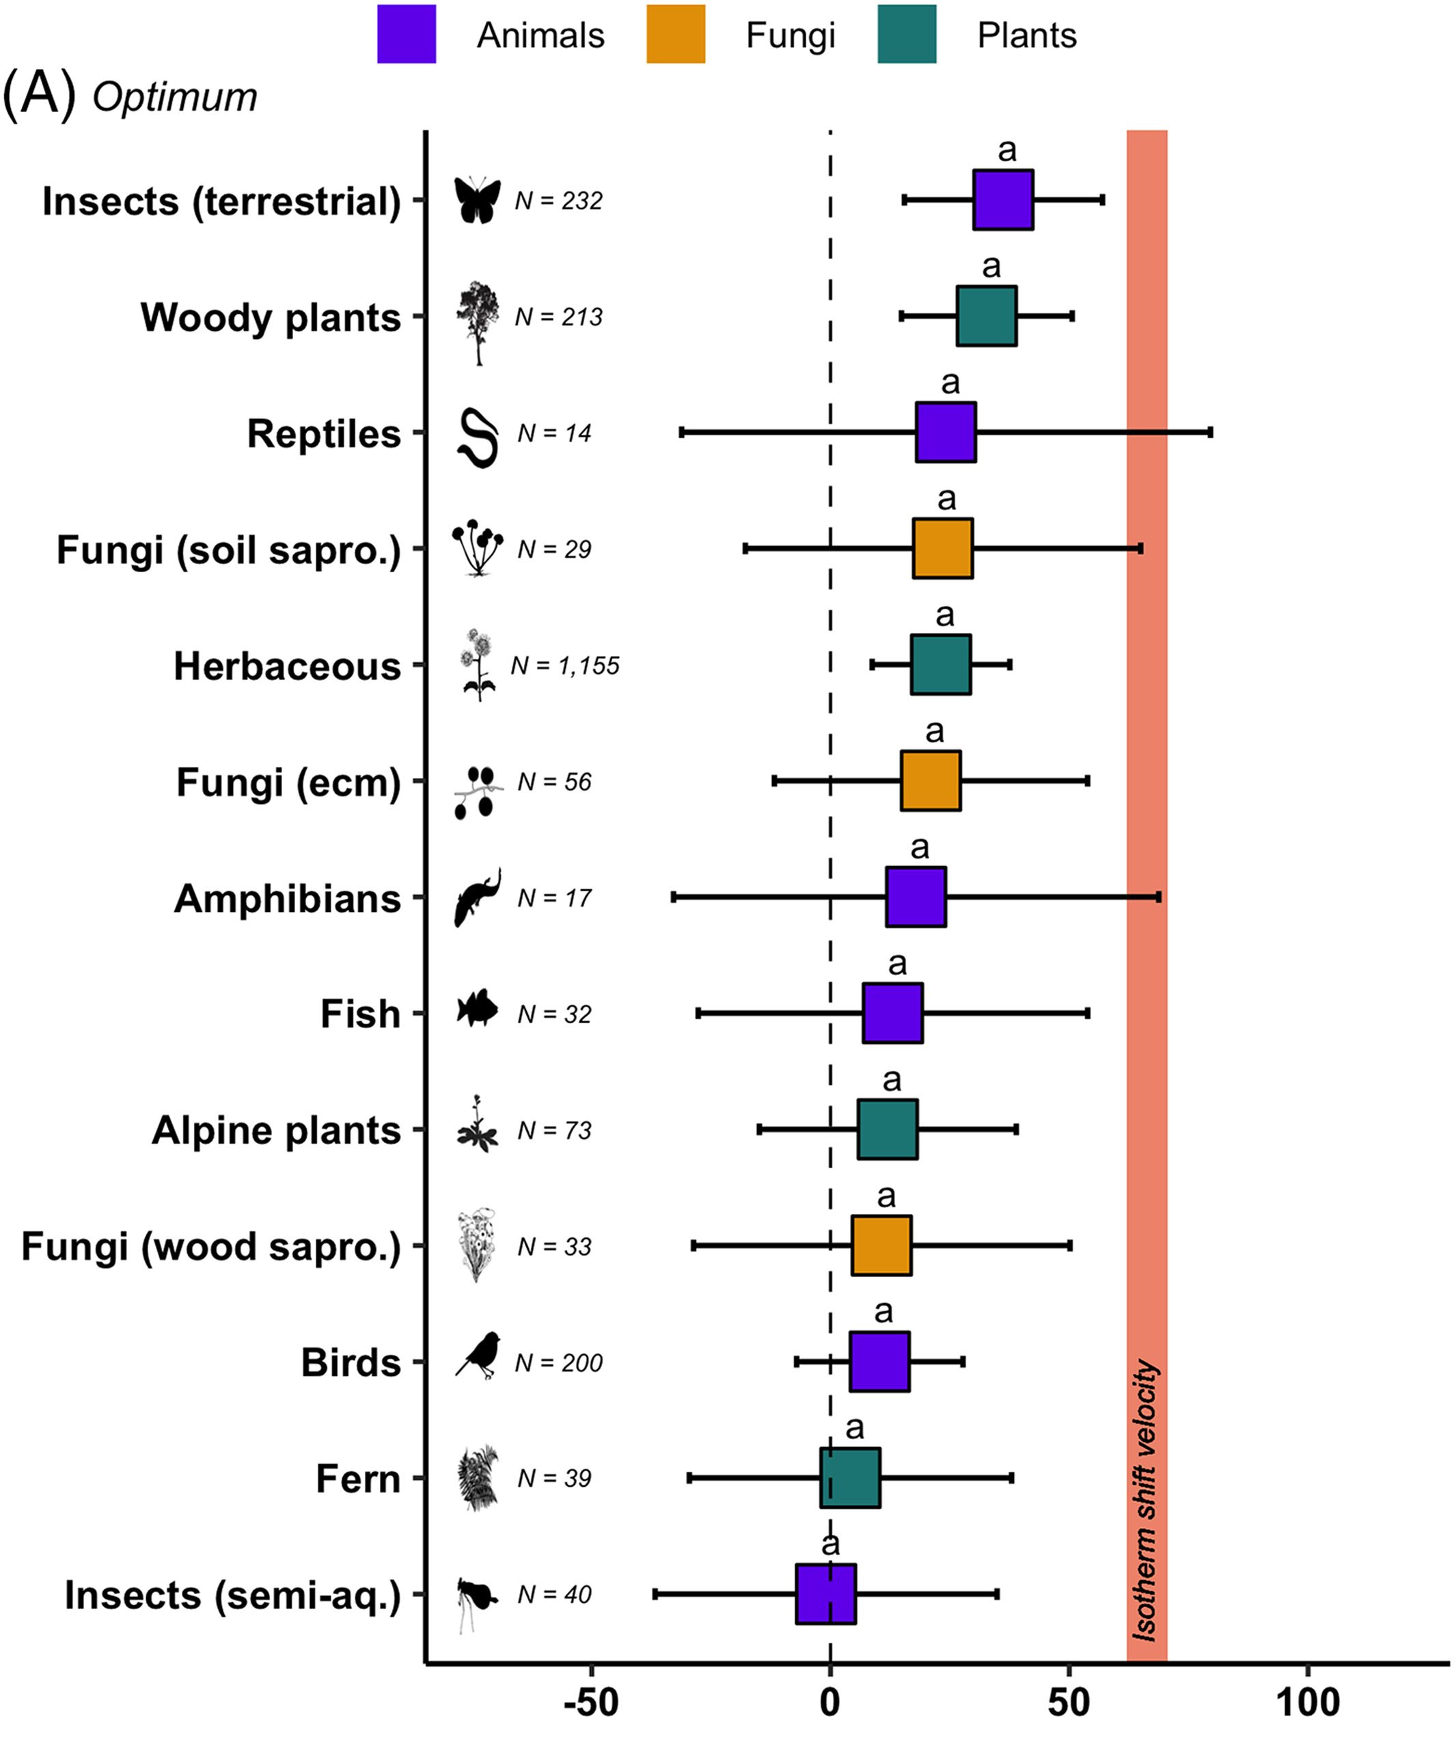
Desplazamientos en altura de plantas, animales y hongos bajo el cambio climático en los Alpes europeos
Vitasse et al. (2021) Biol. Rev.

Slide 4
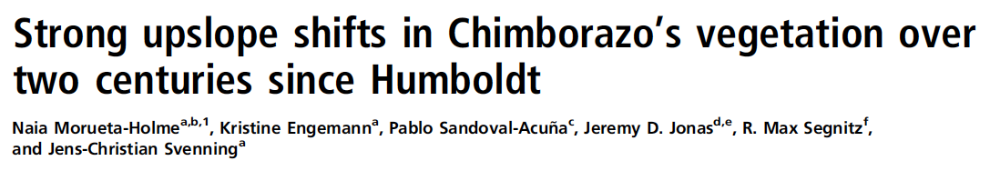

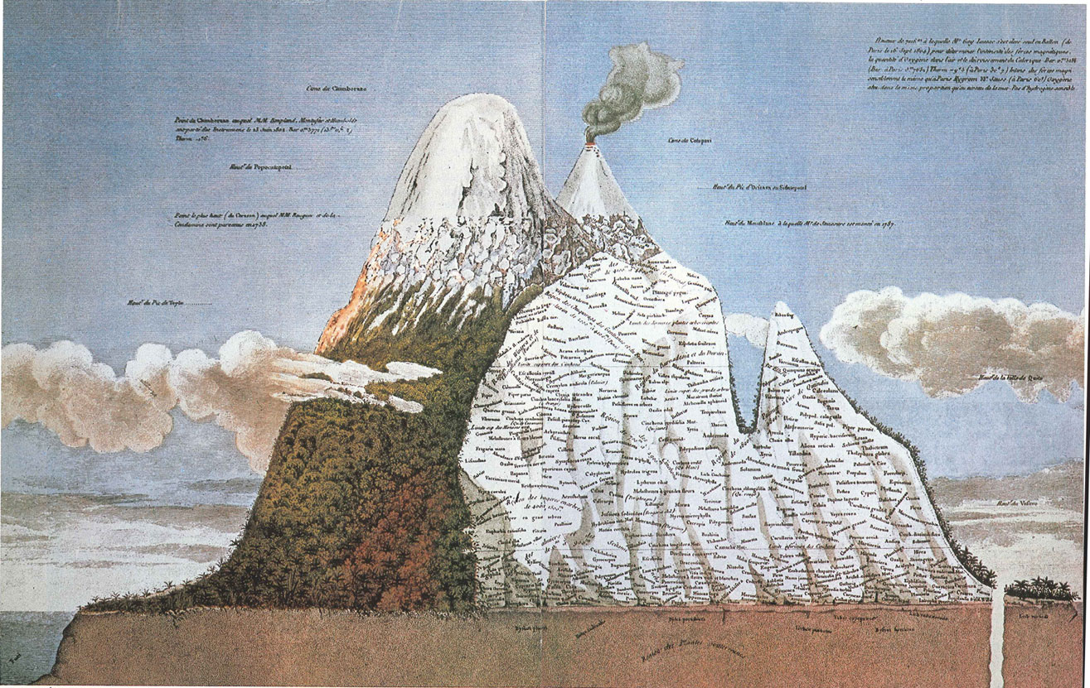

Slide 5
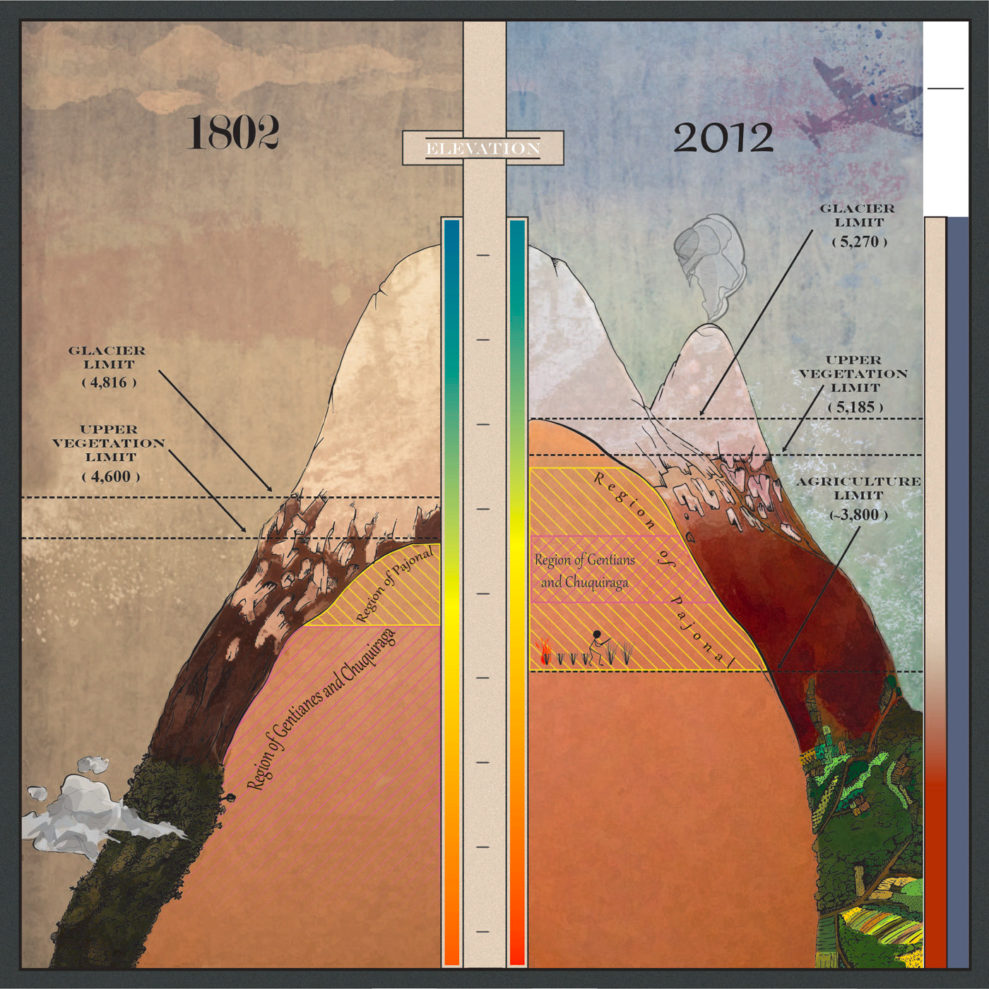

Slide 6
Cuando descubrí a Humboldt

Slide 7
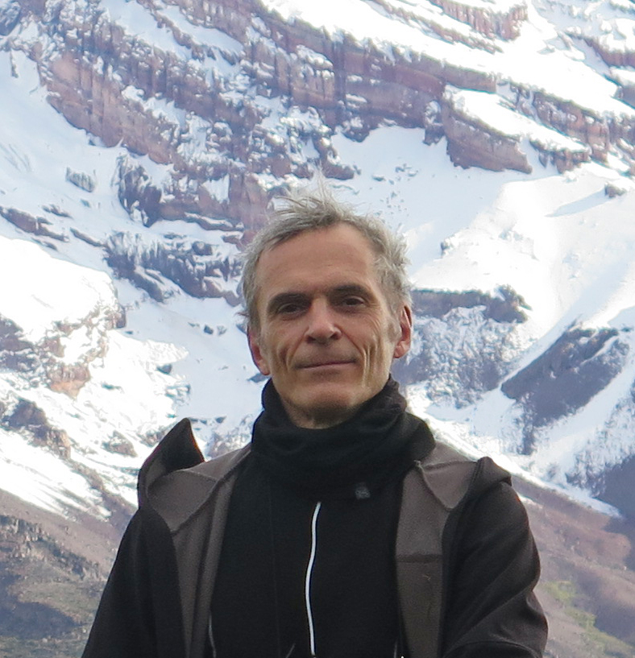
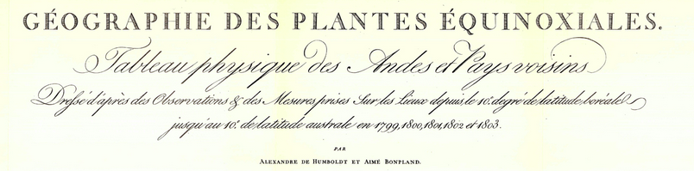
Pierre Moret
Historiador

Slide 8
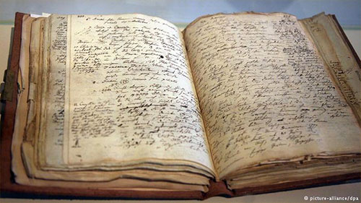
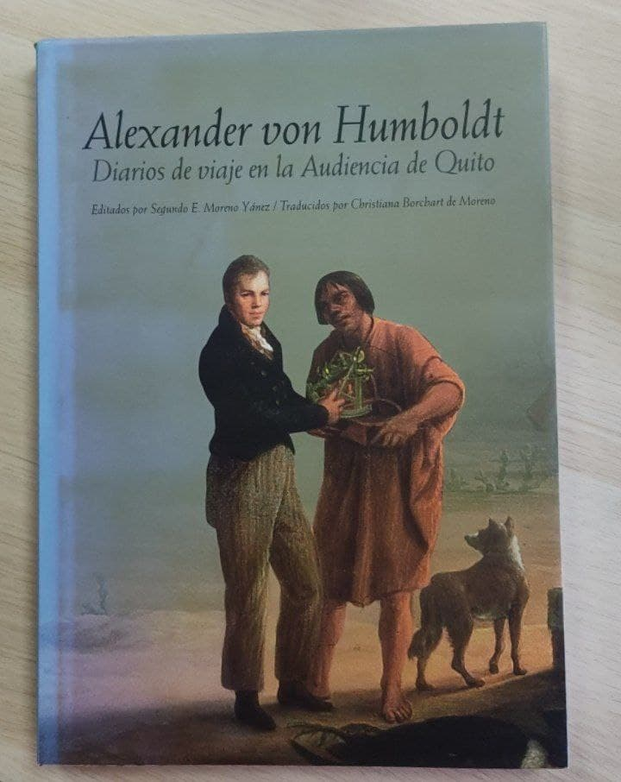

« On June 23, 1802 (the same day three years ago we had climbed Pico del Teide), we ascended Mount Chimborazo. (...) The bad weather made everything
impossible. (...) Our visit of this immense elevation was exceedingly depressing
and gloomy. (…) Of all the Nevados we visited, Chimborazo possesses the fewest plants. (...) In addition, a vegetation without vigor, not adapted to the beauty of this colossus. »

Slide 9
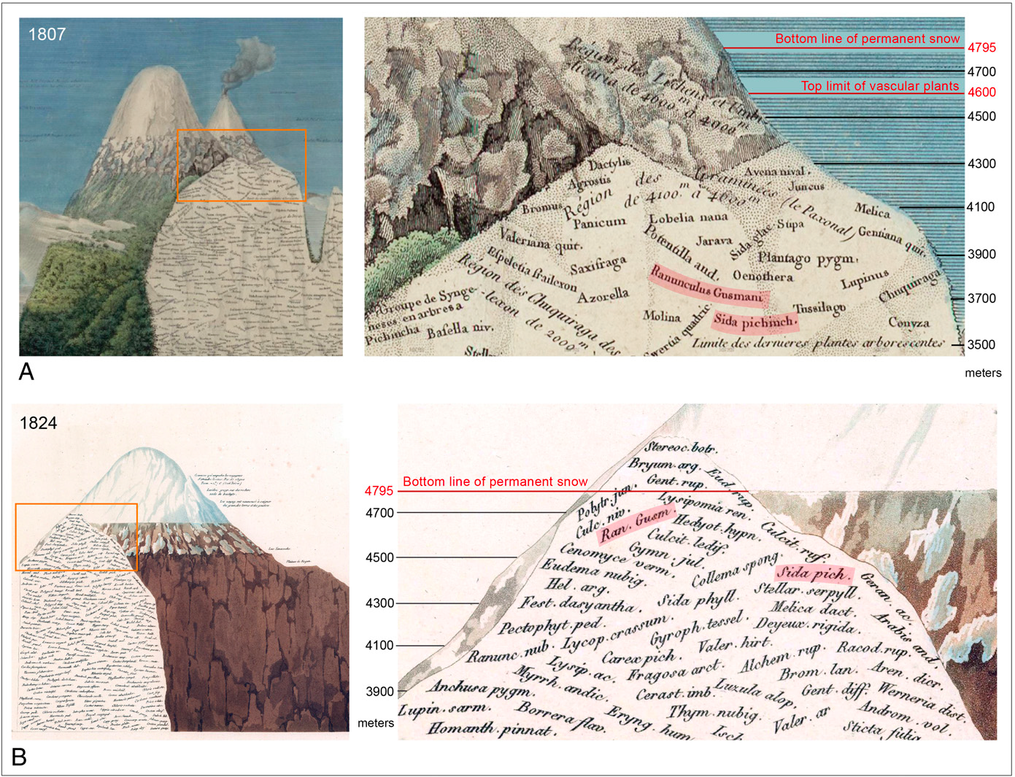
Moret et al. (2019) PNAS

Slide 10
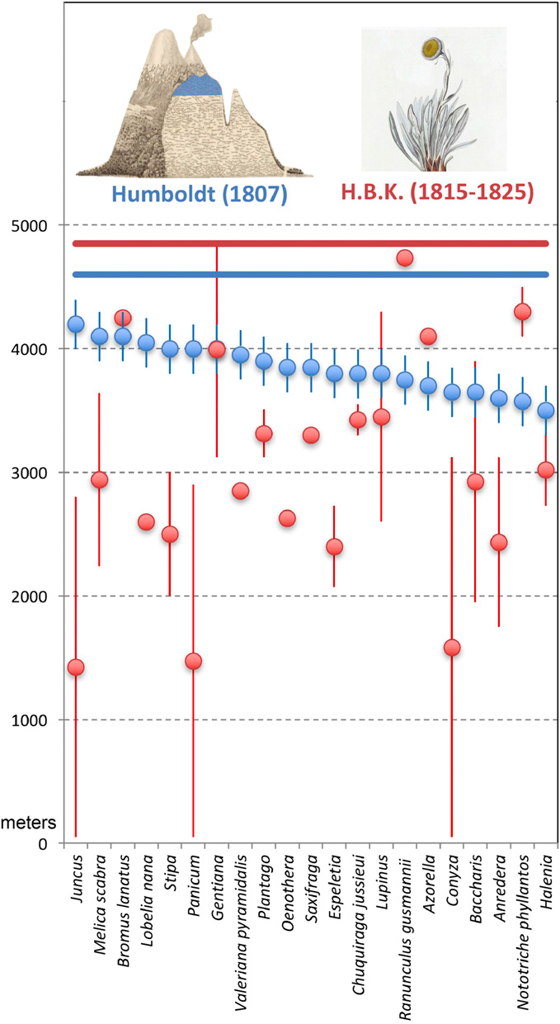
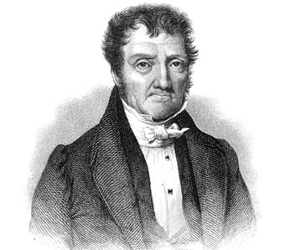
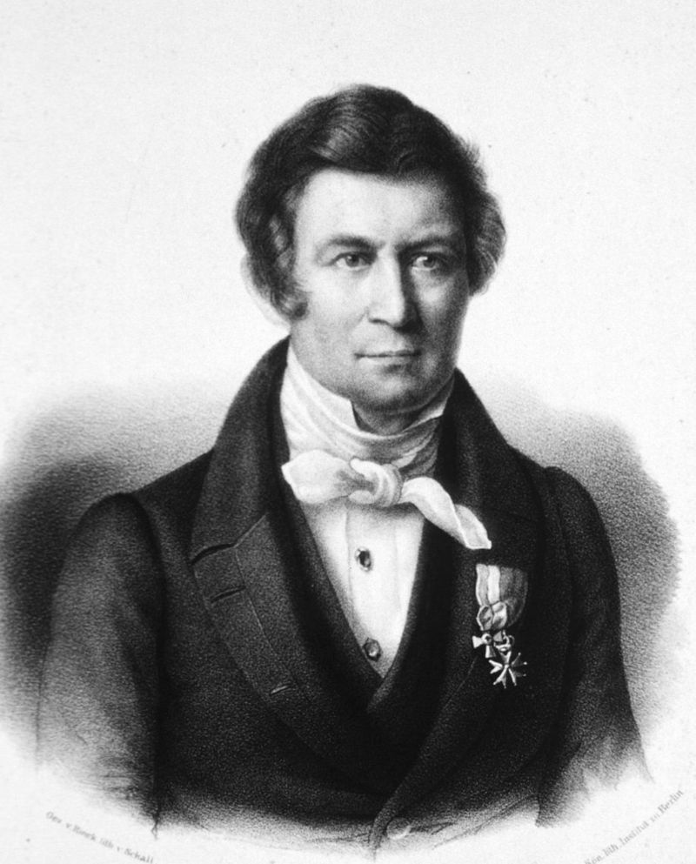
Moret et al. (2019) PNAS

Slide 11
¿Que tipo de datos necesitamos?

Slide 12
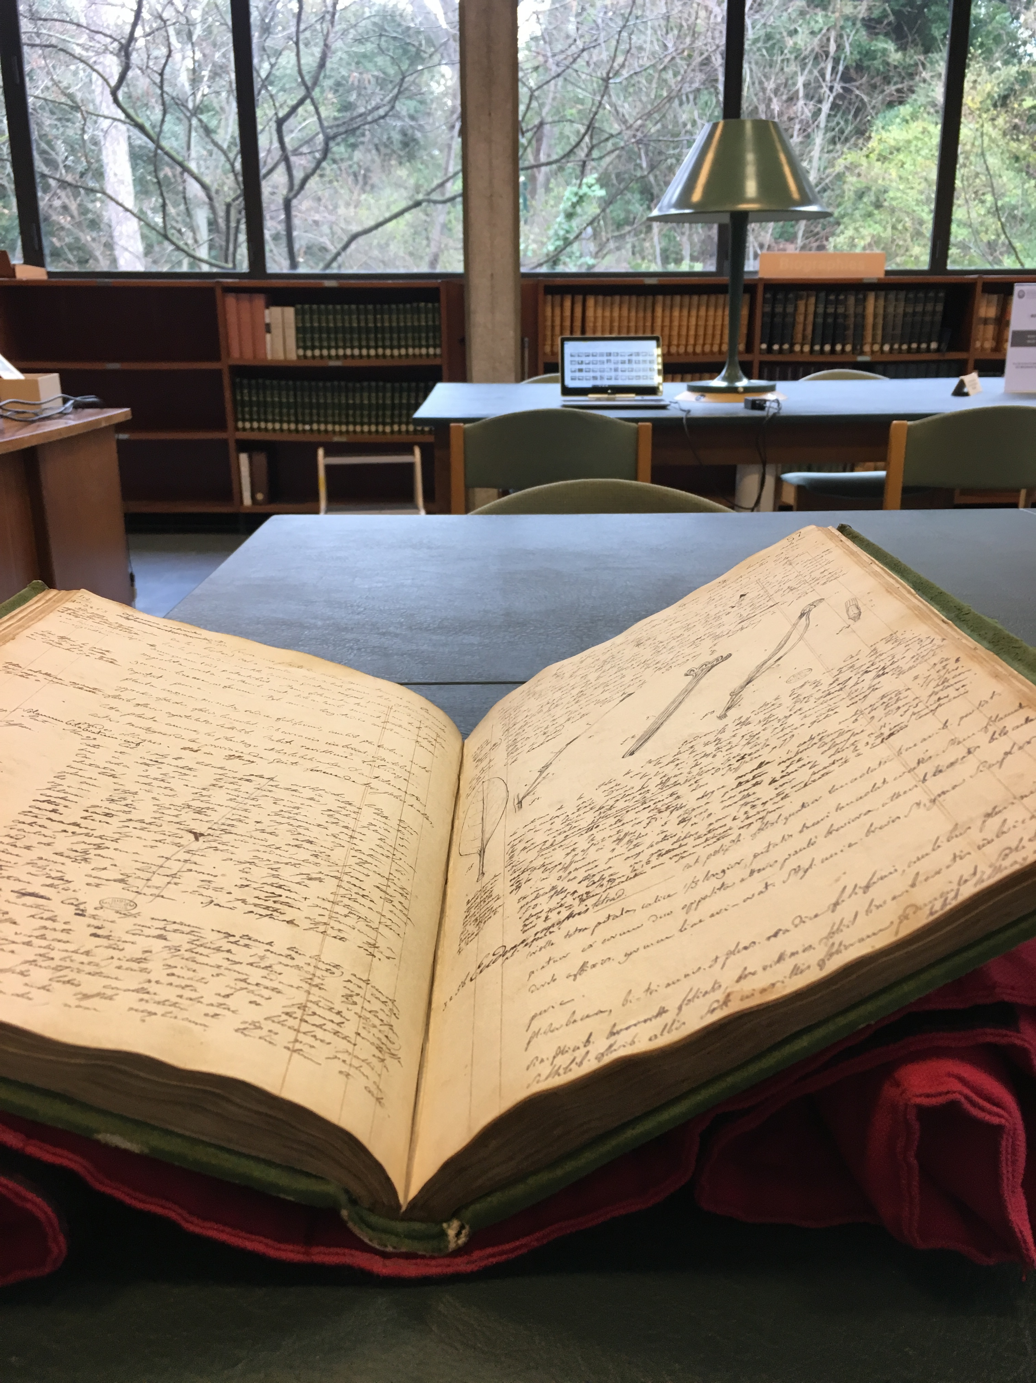

Slide 13
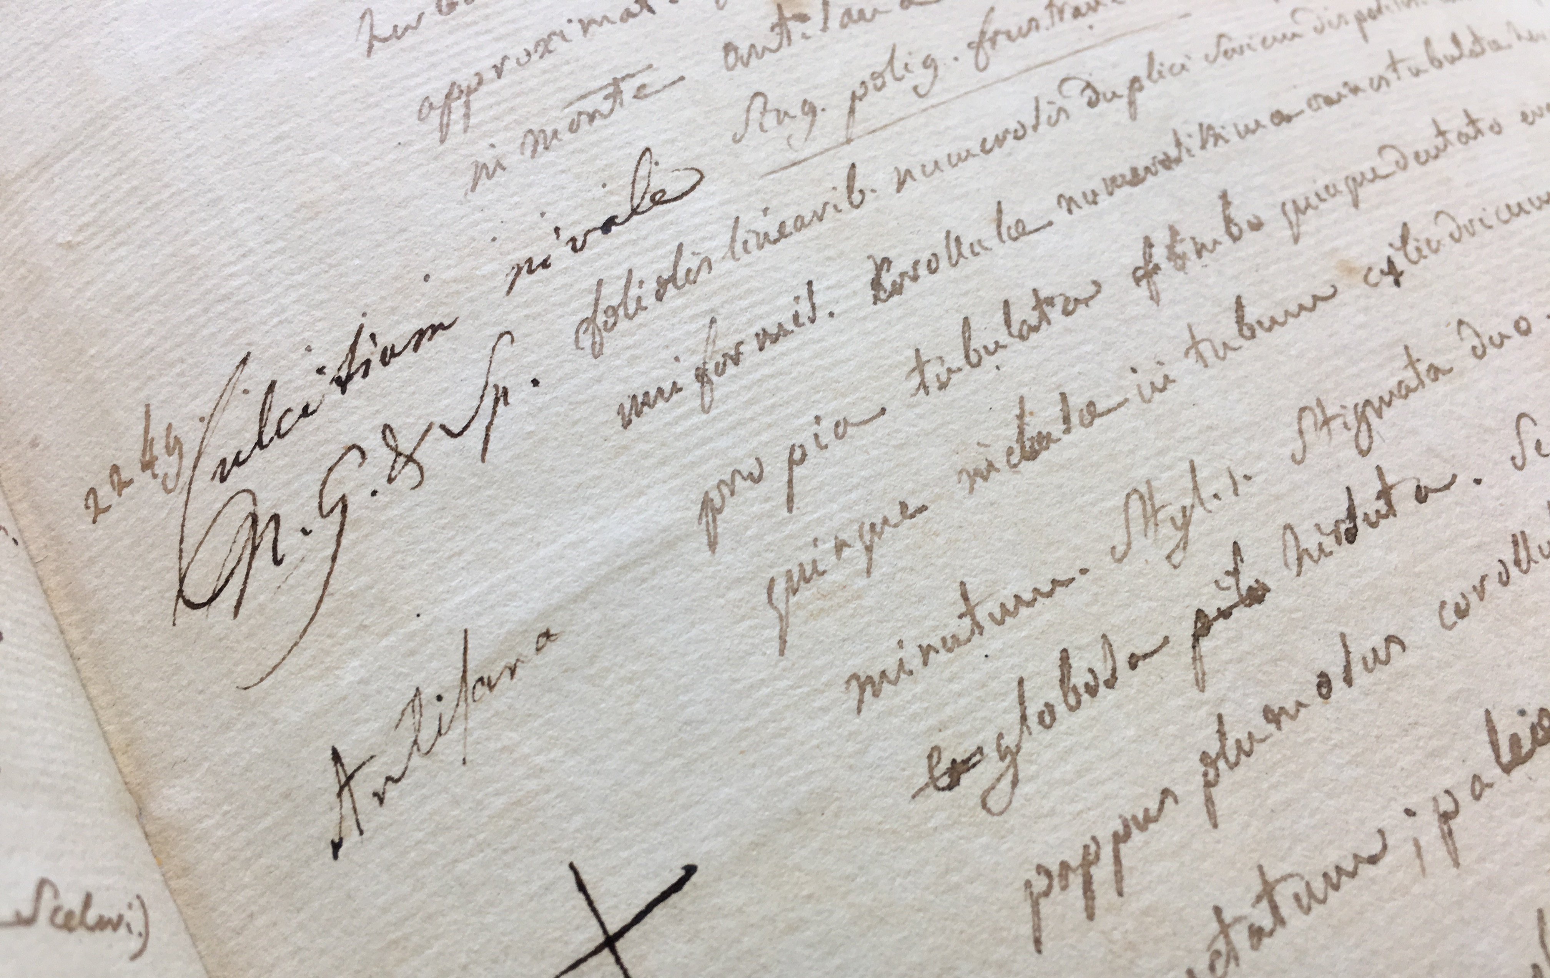
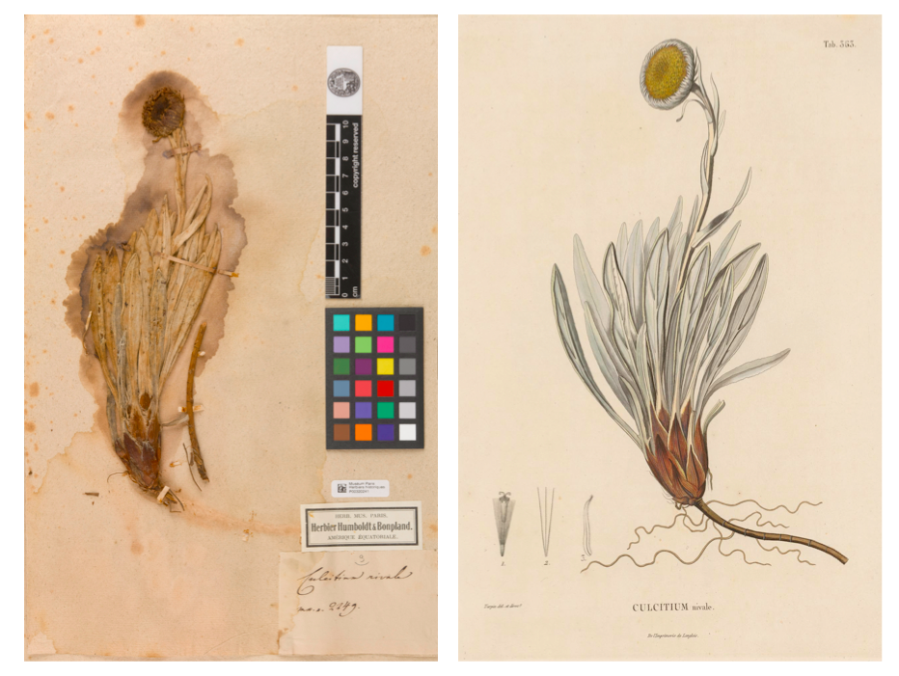
A
B
C

Slide 14
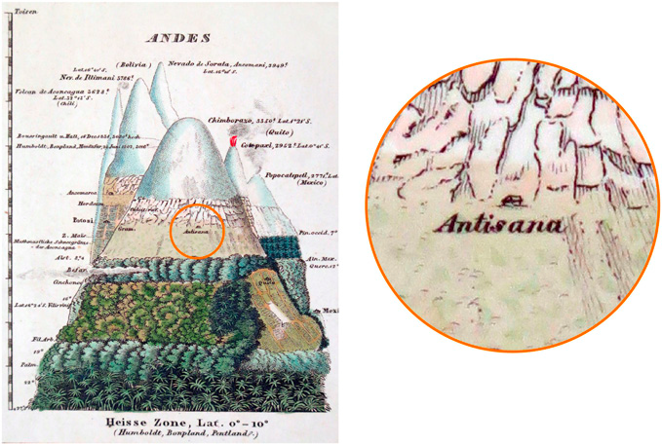
Moret et al. (2019) PNAS

Slide 15
¿Ahora, que teníamos que hacer?

Slide 16
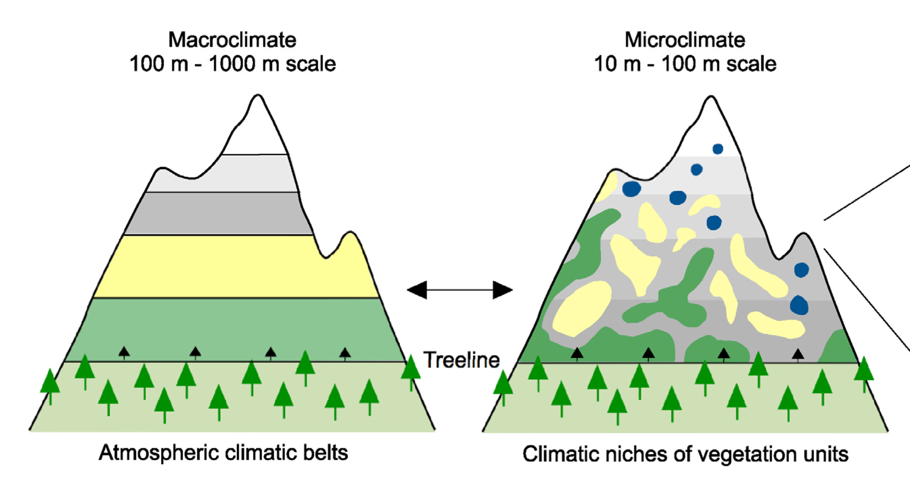
Körner and Hiltbrunner (2021) Diversity

Slide 17
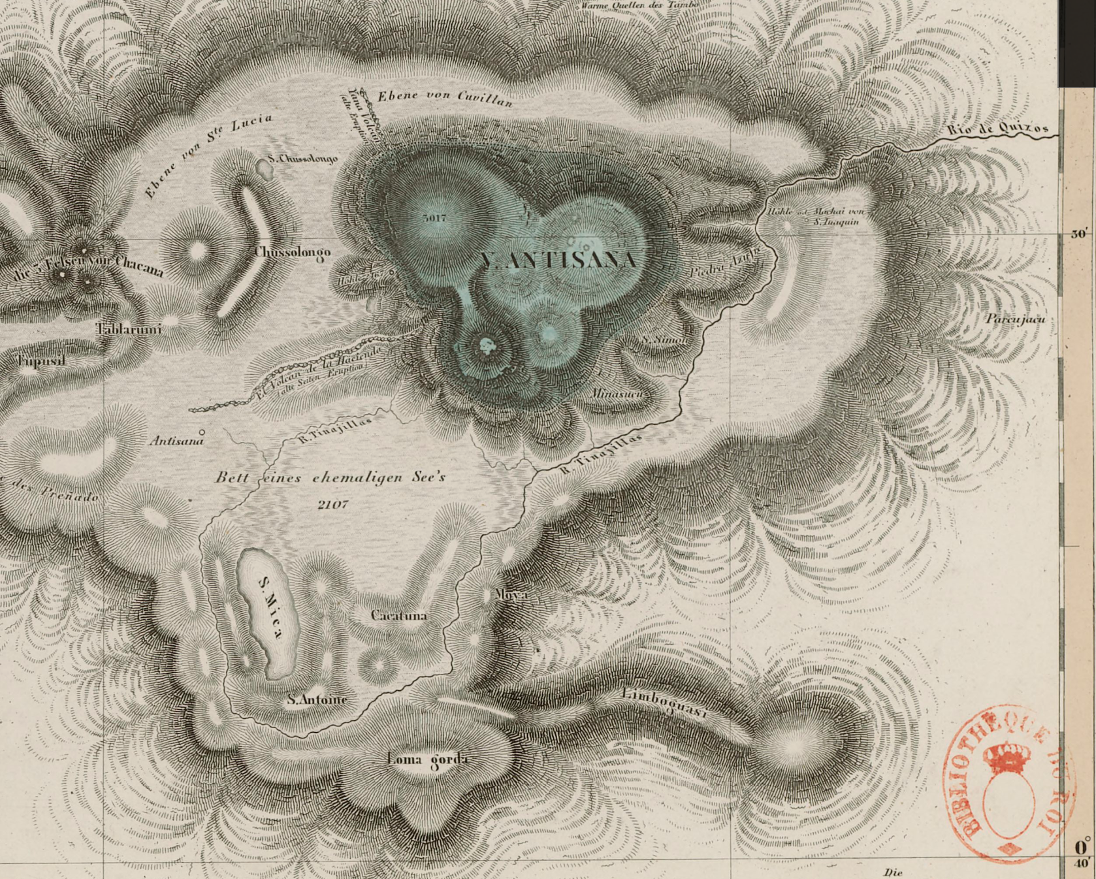
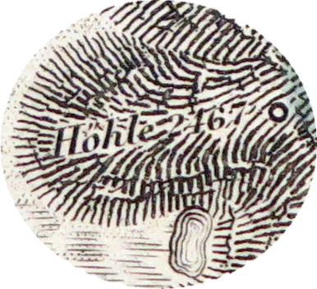
❸
❹
❷
❶
❹

Slide 18
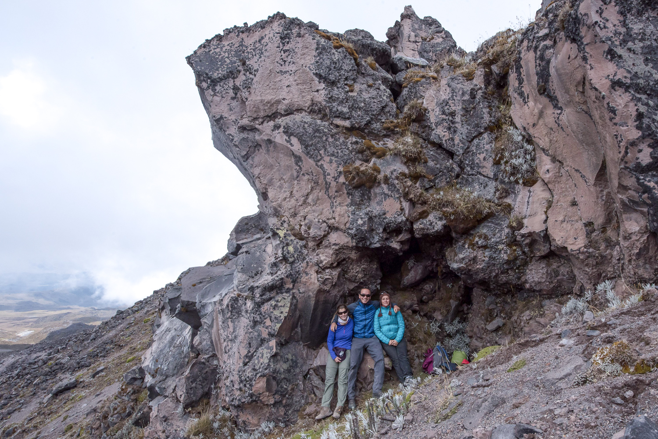

Slide 19
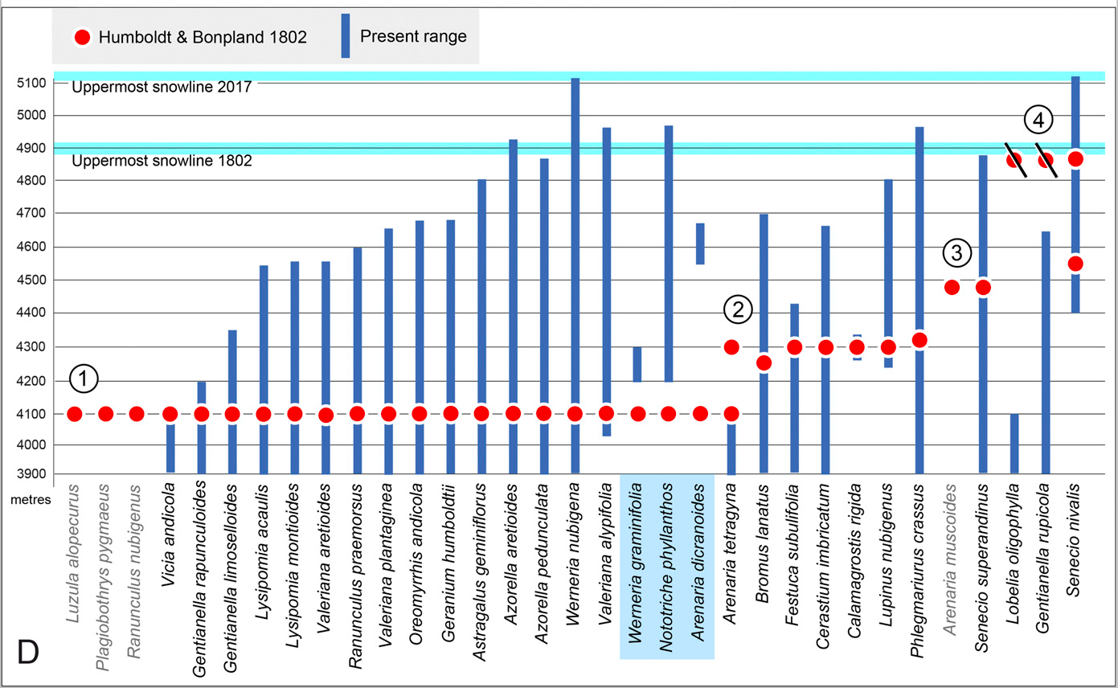
Moret et al. (2019) PNAS

Slide 20
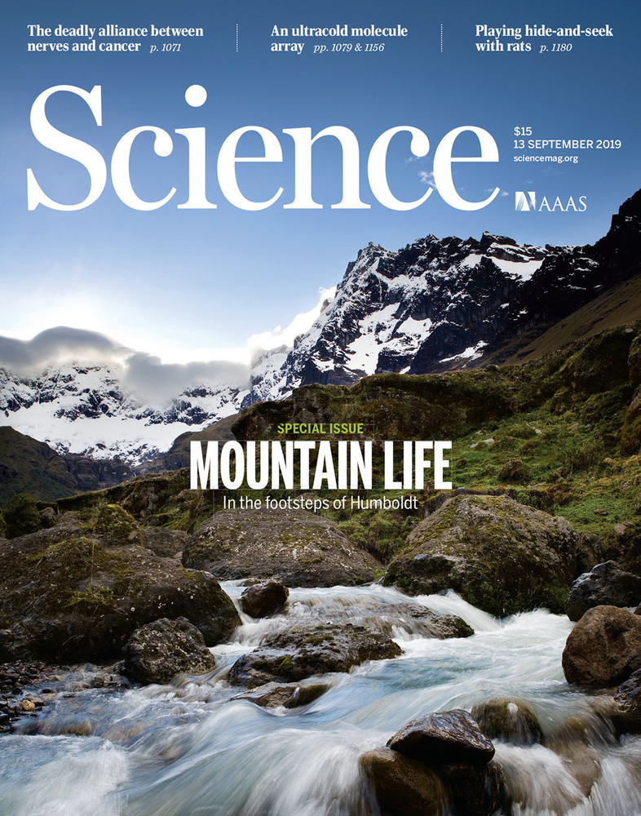
« In contrast to Moret et al.’s claim, we do not agree that later versions of Humboldt’s Tableau Physique are necessarily more correct than earlier ones, as the latter were done while the field work was more fresh in the memory. »
« whether the data illustrated on the Tableau Physique is all 100% correct is not as critical as Moret et al. imply, as the overall upward vegetation shifts are also supported when using other data sources. »

Slide 21
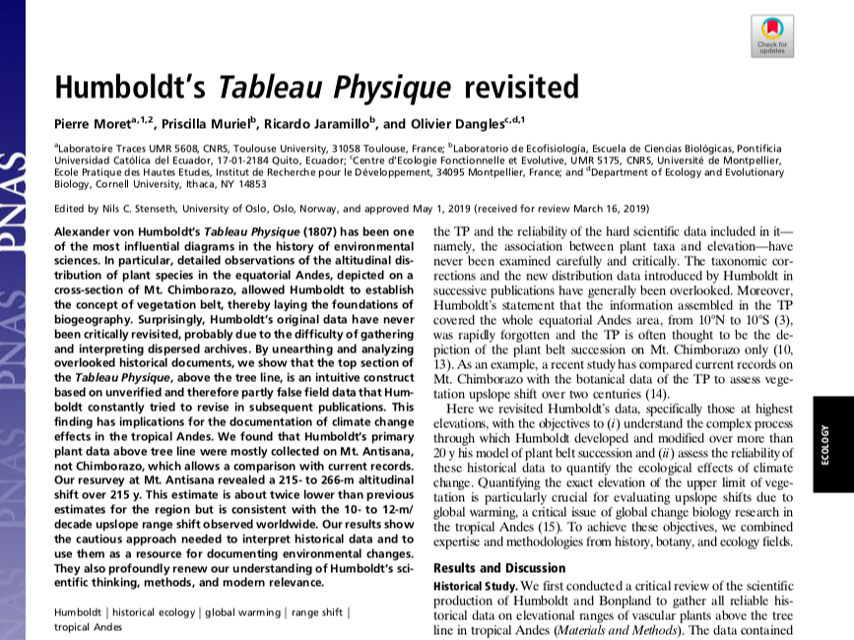

Slide 22
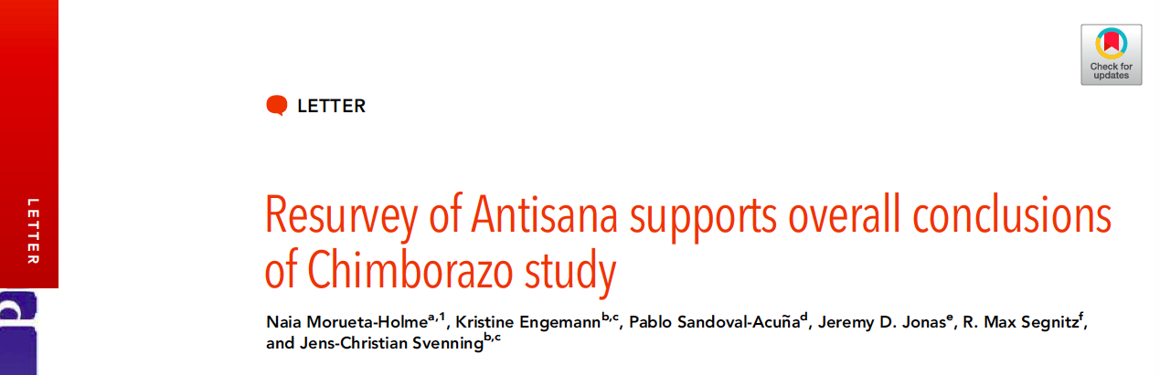
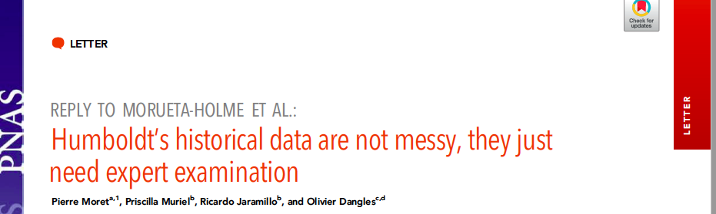
« Messy historical data, open to interpretation, pose difficulties for inferring precise range shifts and yet indicate trends and general estimates »

Slide 23
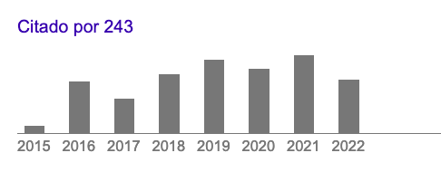
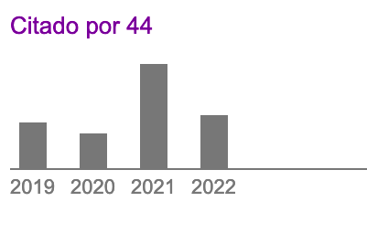
¿Donde estamos 4 años despues?
Morueta
Moret

Slide 24



